Slide 1
Professional Electronic Messaging
Week 4, Unit 4
CC11 Communication in the Workplace

Slide 2
Table of Contents
Emails for business communication
Creating a professional email address
Parts of an email
Best practices for constructing business emails

Slide 3
Email for Business Communication

Slide 4
Introduction to the Email
Electronic Mail
AKA email or e-mail,
Exchanging messages (mail) through digital computers in a network
One of the most commonly used digital means of communication
Mostly used in professional settings (workplaces, industries, academe, etc.)

Slide 5
Advantages for Email in Business
More reliable security issues
Access contacts very easily
Can be tracked if using a business email
Filter out emails (type, nature of email, user, attachments)
Attach links and attachments with a huge size
Can be used for both formal and informal conversation
Has a subject line; can identify the matter at hand

Slide 6
Common Uses for Email in Business
Sending company memos
Collaborating with other entities inside / outside of the company
Sending files that have a huge file size
Informal communication with other members of the team
Requesting and acquiring information from outside companies
Applying for jobs, internships, admissions, and scholarships

Slide 7
Creating a Professional Email Address

Slide 8
Company Email Addresses
Type of email address that is associated with a company
Formatted with the company name at the end
Created by the company themselves
dcmalabanan@uc-bcf.edu.ph
dcmalabanan@dost.gov.ph
dcmalabanan@ph.fujitsu.com

Slide 9
Personal Email Addresses
Types of email addresses that is created by the user with an existing email domain
Used for all types of purposes, mostly personal
dcmalabanan@gmail.com
dcmalabanan@outlook.com
dcmalabanan@yahoo.com

Slide 10
Do’s in Creating Email Addresses
Choose the right email domain
Gmail (@gmail.com)
Outlook (@outlook.com)
Yahoo (@yahoo.com)
Use your first and last names on the email address
dcmalabanan
donmalabanan
doncmalabanan
Adding random numbers is acceptable

Slide 11


Privacy Emails
Type of email domain that focus on security through encryption of emails
Used mostly for personal emails

Slide 12
Don’ts in Creating Email Addresses
Variations on User’s Name
Use pet / nicknames
Use cutesy prefixes / suffixes
Use full name
Use modified spelling on the name

Slide 13
Don’ts in Creating Email Addresses
Numbers in Username
Use any relevant dates
Use any relevant numbers (i.e. mobile numbers)
Mobile numbers
Telephone numbers
Home address numbers

Slide 14
Don’ts in Creating Email Addresses
Other Don’ts in Creating Email Addresses
Include references to race, gender, religion, or any discriminatory information
Use university name after graduation

Slide 15
Other Best Practices for Using Email Addresses
Use emails for different purposes
Use your UC student account as a student in UC
Create a different email for signups
Create an overall personal email
Make sure that the username is relatively easy to pronounce
Keep the username as short as possible

Slide 16
Parts of an Email Message

Slide 17
Parts of an Email Message
Recipients
To
CC
BCC
Subject line
Body of the email

Slide 18
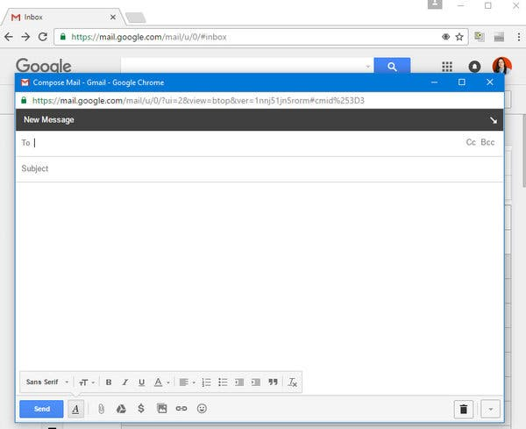
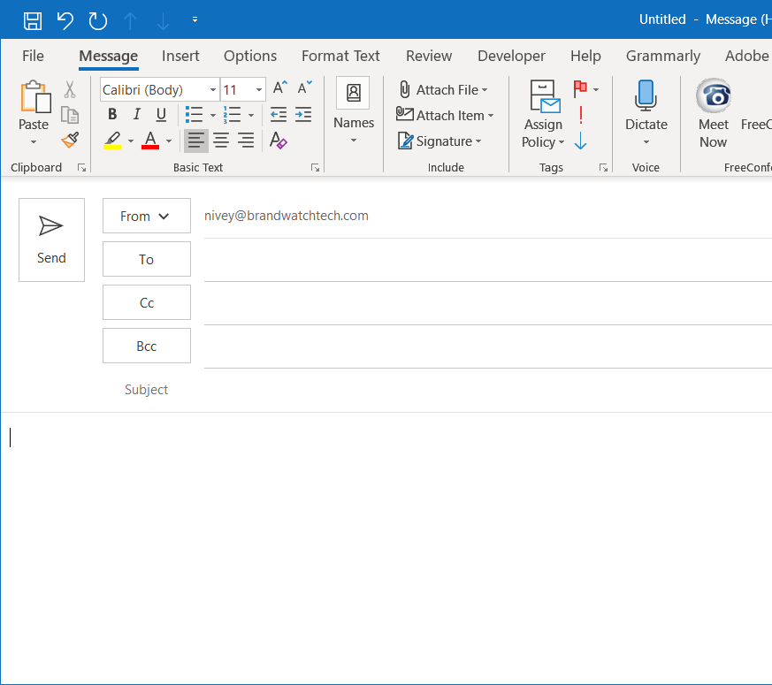
Interface for Composing Emails

Slide 19
Recipients
Refers to the persons / groups / organizations to which you want to send the email to
Three types of recipients:
To – main recipients of the email; are required to take action; no set maximum limit
CC (carbon copy) – secondary recipients of the email; not required to take action; usually used for heads of the TO recipients; limit to around 5 recipients
BCC (blind carbon copy) – sending emails to recipients but do not want anyone else to know you sent it to them; mostly used for mailing lists

Slide 20
Subject Line
First message seen when sending an email to an inbox
Gives the subject of what the email is about
Helps filter out the nature of the messages and what needs to be prioritized by the recipient of the message

Slide 21
Subject Line
Tips in Creating a Subject Line
Keep it short (around 10 words)
Remove filler words
Add nature of the email in the first words
Include a call to action
Prevent using promotional words
Personalize the subject line
Prevent using all caps
Use capital letters on the first letters of the word

Slide 22
Subject Line – Examples
Sample Situation | Sample Subject Line
Memorandum on in-house vaccination | [Memo] Vaccination on Feb. 3, 2022
 | Memo on Vaccination Schedule
 | Vaccination Schedule for Employees
Submission of risk assessment document | URGENT: Risk Assessment Document
 | Urgent Submission on Risk Assessment Document
 | Reminder: Submission of Risk Assessment Document on Feb. 3, 2022

Slide 23
Body of the Email
Includes all parts of the email
Follows similar construction to that of a letter:
Salutations / greetings
Body of the letter
Closing remarks
Name of sender

Slide 24
Body of the Email
Specialized Email Functions
Bullet points
File attachments
Signature
Delayed sending

Slide 25
Body of the Email
Specialized Email Functions – Bullet Points
Though can be done in letters, it is mostly seen in emails
Highlight / list down points of action using bullet points
Types of bullet points:
Unordered bullets (black circle)
Ordered bullets (1, 2, 3…)
Quotations (used to refer to previous statements on another email)

Slide 26
Body of the Email
Specialized Email Functions – File Attachments
Attach anything (usually PDFs, word documents, spreadsheets, presentations, images, etc.) with the email
For signed documents, use PDF
When doing so, include a statement to this email:
Example: Attaching a risk assessment document (in PDF)
Attached to this email is the requested risk assessment document.
Below is the attached document.

Slide 27
Body of the Email
Specialized Email Functions – Signature
Automatically add a signature at the end of the email
Can include the following:
Closing remarks
Name and position
Name and logo of the institution
Disclaimer policies
Prevent the following:
Quotations
Unnecessary logos and designs

Slide 28
Body of the Email
Specialized Email Functions – Signature
Tips in creating a specialized signature:
Create different signatures for different occasions
Match the formatting with the formatting in the email
The most important parts must be in bigger fonts; the disclaimer policies may be placed smaller
For the images, use a very small size file and ensure that it is in JPEG format
Maintain professionalism in the creation of the signature

Slide 29
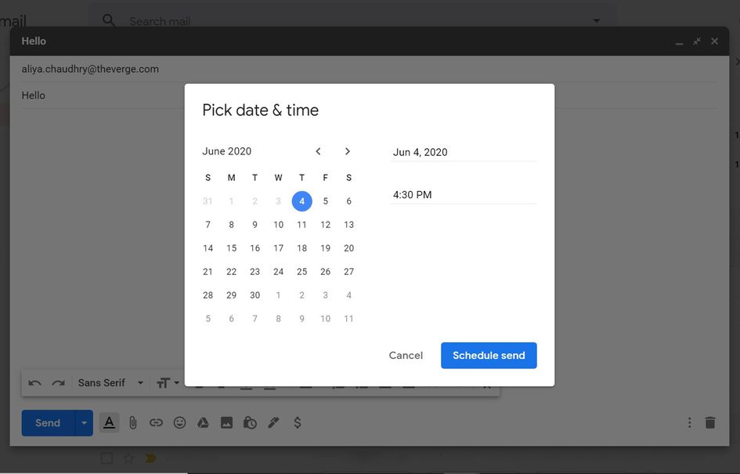
Body of the Email
Specialized Email Functions – Delayed Sending
Send a message within a given time and date
This is especially useful when responding to recipients with a strict set of office hours

Slide 30
Best Practices for Constructing Business Emails

Slide 31
Best Practices in Email Construction
Use the same tips when creating business emails
Maintain a professional tone
Formal / informal greetings and closing remarks are to be used accordingly
Keep it short and simple
Have a call to action
Choose and maintain a specific font style, size, and color
Dependent on the grounds of the company

Slide 32
References
https://www.educba.com/what-is-email/
https://www.linkedin.com/pulse/email-etiquette-students-part-1-choosing-right-address-ramees/
https://blog.thedigitalgroup.com/to-vs-cc-vs-bcc-how-to-use-them-correctly
https://uwaterloo.ca/writing-and-communication-centre/resources-writing-professional-emails-workplace
https://drexel.edu/graduatecollege/professional-development/blog/2018/october/12-tips-for-writing-effective-emails/

